Slide 1

s
Presentation
On
EMAIL AUTOMATION USING LLMS
Group Number: 26
Presented by
VIVEK KUMAR
VATSAL CHAUDHARY
VISHVESHVER
SHREYANSH SINGH RATHORE
Under the Supervision
DR. ASIF KHAN
(Department of CSE _GNIOT Greater Noida, India)

Slide 2
Table of Contents
1.Introduction
2.Research Objectives
3.Literature Survey
4.Proposed Model
5.Discussion About Methodology & Algorithm
6.Conclusion & Future Work
7. Research Paper Progress
8.References

Slide 3
1.Introduction
Email remains one of the most widely used communication channels globally, with over 300 billion emails sent daily across professional and personal domains.
Manual email drafting is time-consuming, repetitive, and often lacks personalization, leading to reduced productivity in enterprise environments.
Recent advances in Large Language Models (LLMs) offer a transformative approach to intelligent email automation, enabling context-aware generation, summarization, and personalized communication at scale.
This project proposes an AI-powered email automation platform that leverages LLM capabilities to generate professional email drafts, summarize threads, rewrite content in different tones, classify emails, and detect priority levels.

Slide 4
2.Research Objectives
Reduce the time required for drafting professional emails through automated LLM-based content generation.
Improve personalization in automated email communication by incorporating user preference memory and contextual awareness.
Enable context-aware email generation that can summarize threads, rewrite content in different tones, classify messages, and detect priority.
Evaluate productivity improvements achieved through LLM-based email automation compared to traditional manual drafting approaches.
Design a modular and scalable system architecture comprising a backend processing layer, prompt construction module, LLM integration layer, and analytics and monitoring module.

Slide 5
3.Literature Survey
Transformer-Based Language Models: The transformer architecture (Vaswani et al., 2017) introduced self-attention mechanisms that revolutionized natural language processing and enabled modern LLMs.
Advances in LLM Text Generation: Models such as GPT-4, Gemini, and LLaMA demonstrate state-of-the-art performance in contextual text generation, summarization, and tone adaptation tasks.
Prior Email Automation Approaches: Earlier systems relied on rule-based templates and keyword matching, providing limited contextual understanding and personalization capabilities.
Limitations of Template-Based Systems: Template-driven approaches lack adaptability to diverse communication styles, fail to capture nuanced context, and produce generic, impersonal responses.
Prompt Engineering Techniques: Recent research highlights the importance of structured prompt design in optimizing LLM output quality for domain-specific applications such as professional email composition.

Slide 6
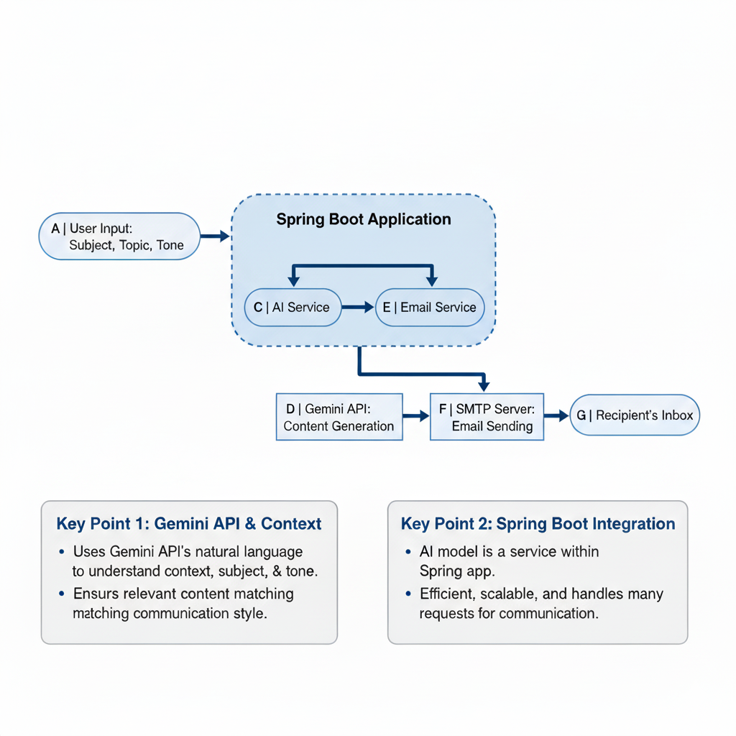
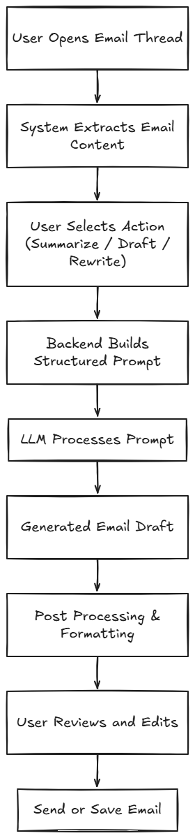
4.Proposed Model

Slide 7
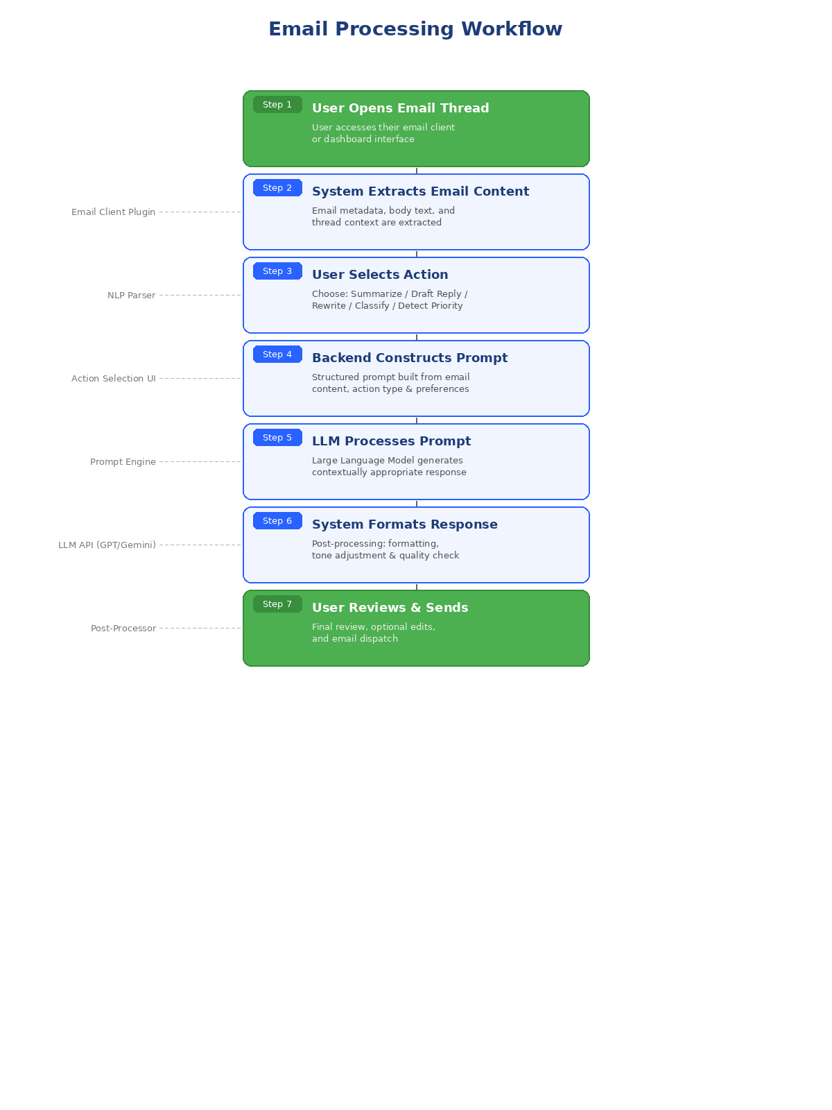
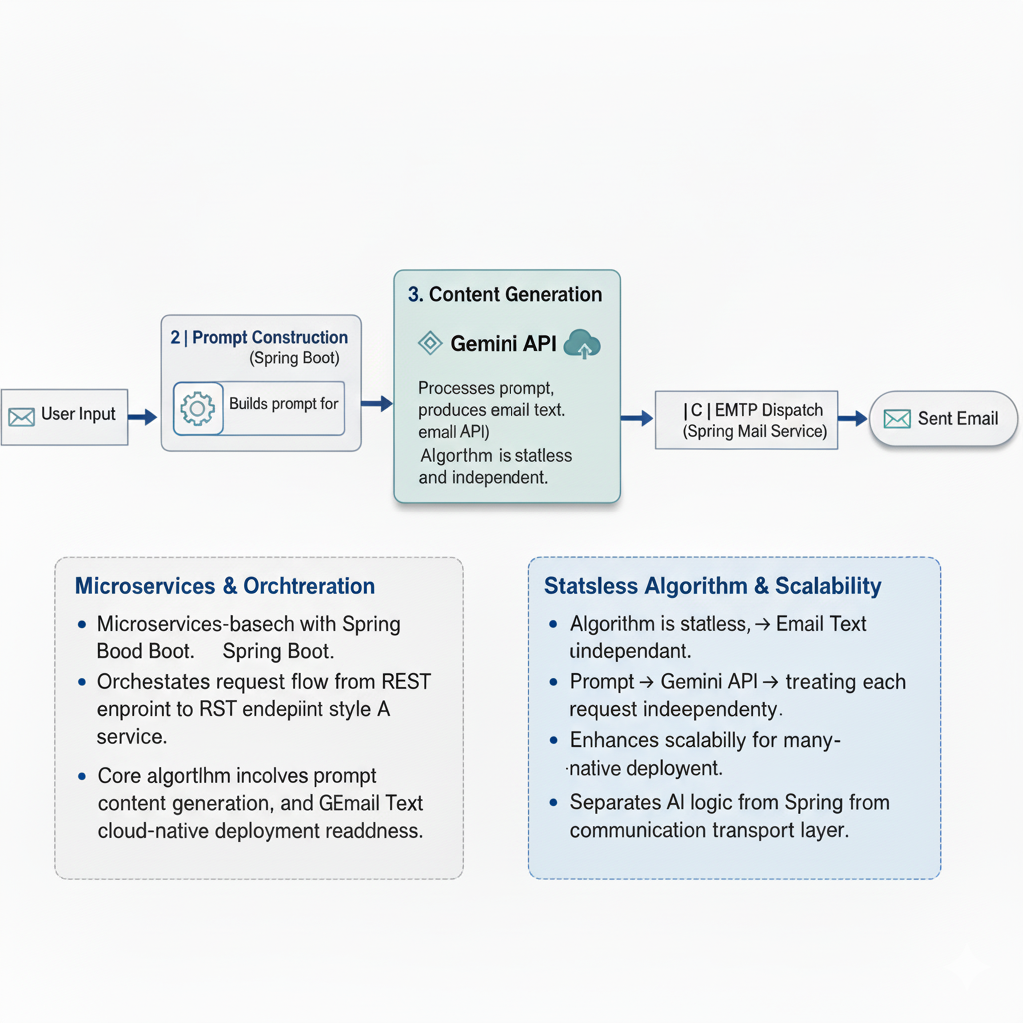
5.Discussion About Methodology & Algorithm

Slide 8
6.Conclusion & Future Work
Conclusion:
LLM-based email automation systems can significantly reduce the manual effort and time invested in professional email drafting and communication.
The proposed architecture demonstrates effective integration of prompt construction, LLM processing, and post-processing layers to generate contextually appropriate and personalized email content.
Future Work:
Multilingual email generation to support global enterprise communication.
Improved personalization through advanced user preference learning and behavioral analysis.
Enterprise system integration with CRM, ERP, and collaboration platforms.
Context-aware AI assistants capable of proactive email management and intelligent scheduling.

Slide 9
7. Research Paper Progress
Architecture Design: The system architecture comprising the user interface layer, backend processing layer, LLM processing layer, post-processing layer, and data intelligence layer has been finalized.
Literature Review Completion: A comprehensive review of transformer-based models, prompt engineering techniques, and prior email automation systems has been completed and documented.
Prototype System Development: An initial prototype demonstrating core email generation, summarization, and tone rewriting capabilities has been developed and tested.
Experimental Evaluation: Benchmarking and evaluation metrics for measuring productivity improvements, response quality, and user satisfaction are being defined for systematic assessment.

Slide 10
8.References
[1] Vaswani, A. et al., "Attention Is All You Need," Advances in Neural Information Processing Systems (NeurIPS), 2017.
[2] Schulhoff, S. et al., "The Prompt Report: A Systematic Survey of Prompting Techniques," arXiv preprint, 2024.
[3] Google, "Gemini API Reference," Google AI for Developers, 2024. [Online]. Available: https://ai.google.dev/docs
[4] Al-Debagy, O. and Martinek, P., "A Comparative Review of Microservices and Monolithic Architectures," Budapest University of Technology and Economics, 2018.
[5] Dilip, K., "Review on SMTP Protocol for E-Mail Systems," Galgotias University, Department of Computer Science and Engineering, 2020.
[6] Chen, M. et al., "Leveraging Generative AI in Enterprise Applications," IEEE Conference on AI and Business Operations, 2023.

